Slide 1


KNIME
07/06/2024
BRAIN AGE
PREDICTION CONTEST
Vincenzo Luigi Bruno

Slide 2

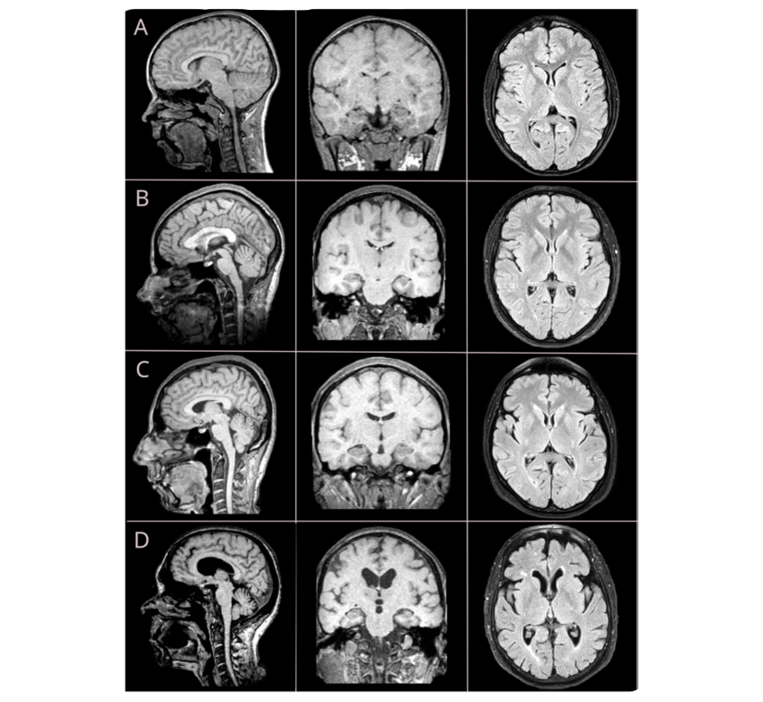
PREDICTING BRAIN AGE IN MULTIPLE SCLEROSIS PATIENTS
Multiple Sclerosis (MS) is a chronic disease affecting the central nervous system, causing physical and cognitive disability.
Aging accelerates brain damage and disability in MS.
Magnetic Resonance Imaging (MRI) is crucial for studying MS, enabling visualization and monitoring of disease activity.
Goal: Develop a machine learning model to predict the chronological age of MS patients from brain MRI scans.
Notes:
This competition tackles a crucial challenge in the field of medical imaging and neurology: **predicting the age of patients diagnosed with Multiple Sclerosis (MS) using features extracted from brain MRI scans.**
**Multiple Sclerosis** is a chronic, often disabling disease that affects the central nervous system. As the disease progresses, it can cause significant physical and cognitive impairments.
**Aging plays a critical role in MS progression, this accelerates brain damage and disability in MS..**
**MRI is an invaluable tool for studying MS.** It provides detailed images of the brain, allowing us to monitor disease activity and assess its impact on brain structure.
**The goal of this competition is to develop a robust machine learning model that accurately predicts a patient's chronological age from their brain MRI data.** This has important implications for:
- **Monitoring Disease Progression:** By comparing predicted brain age to actual age, we can identify individuals who may be experiencing accelerated aging due to MS and tailor treatment
strategies accordingly.
- **Developing Personalized Therapies:** Understanding the relationship between brain age and clinical outcomes can help researchers develop more targeted and effective therapies for MS
patients.

Slide 3

DATASET
The dataset we're working with comprises MRI data from 461 MS patients, divided into a training set (337 patients) and a test set (124 patients).
Importantly, this is a longitudinal study, meaning multiple MRI scans were acquired for many patients over different sessions.
Features: Each MRI scan is represented by 152 numeric features, which were derived from the automatic segmentation of white matter lesions and gray matter regions.
Target Variable: Our goal is to predict the chronological age of each patient, which is provided only for the training set.

Slide 4

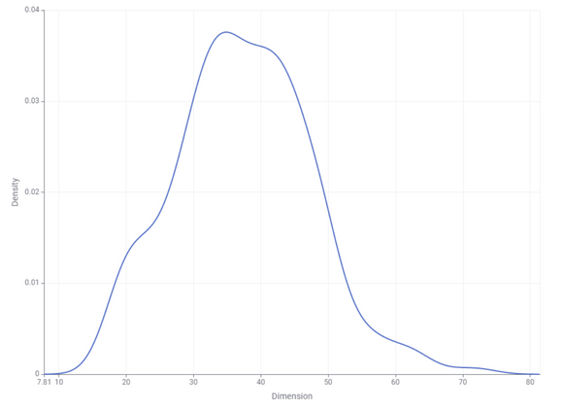
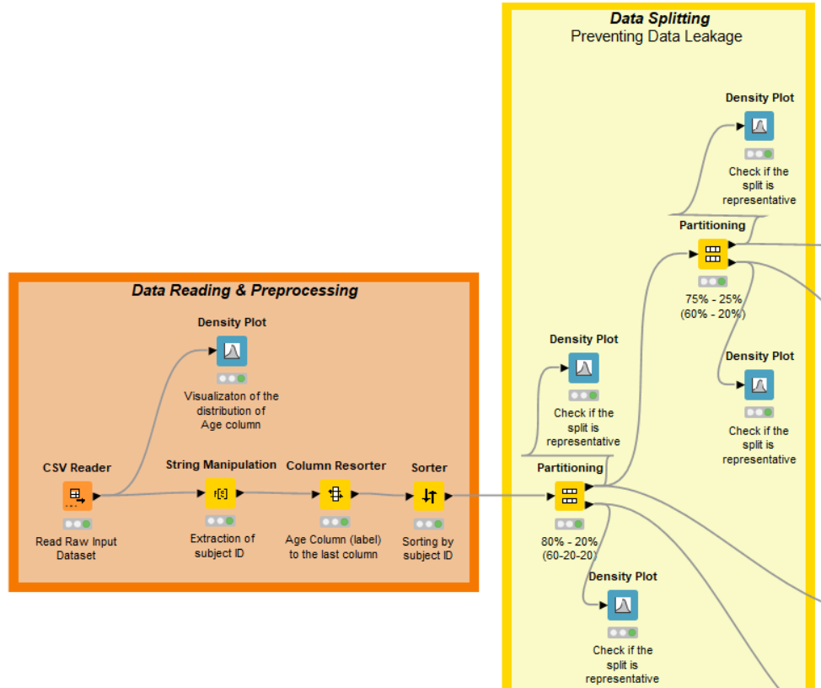
DATA PREPROCESSING AND PREVENTING DATA LEAKAGE
The majority of our patients fall within the 20 to 50 year age range
If we were to randomly split the data into training, validation, and test sets, we would risk introducing data leakage
What is data leakage? It's when information from the training set leaks into the validation or test sets, leading to overly optimistic performance estimates and a model that doesn't generalize well to unseen data.
To prevent this, we took the following steps:
Subject ID Extraction: This allows us to group sessions from the same patient together.
Sorting by Subject ID: This ensures that all sessions for a given patient are contiguous.
Partitioning with "Take from Top": This guarantees that all sessions from the same patient are kept together within the same fold.
Validating the split
Notes:
So, after loading our dataset, the first crucial step was to understand the distribution of our target variable, which is age. As you can see in this Density Plot [point to the Density Plot after the
CSV Reader], the majority of our patients fall within the 20 to 50 year age range. This information is important for evaluating the effectiveness of our data splitting strategy later on.
Now, a major challenge in this competition is the longitudinal nature of the data. We have multiple MRI scans for many patients, taken at different sessions. If we randomly split the data into
training, validation, and test sets, we would risk introducing **data leakage**.
**What is data leakage?** It's when information from the training set leaks into the validation or test sets, leading to overly optimistic performance estimates and a model that doesn't generalize
well to unseen data.
To prevent this, we took the following steps:
1. **Subject ID Extraction:** We used the "String Manipulation" node to extract the unique patient ID from the session ID column. This allows us to group sessions from the same patient together.
2. **Sorting by Subject ID:** We then used the "Sorter" node to sort the entire dataset by subject ID. This ensures that all sessions for a given patient are contiguous.
3. **Partitioning with "Take from Top":** Finally, we used the "Partitioning" node to split our data into 60% training, 20% validation, and 20% test sets. Critically, we used the "Take from Top"
sampling method. This, combined with the previous sorting step, guarantees that all sessions from the same patient are kept together within the same fold (training, validation, or test).
**Validating the Split:**
To confirm that our data splitting strategy resulted in representative subsets, we used Density Plots [point to the Density Plots after each Partitioning node] to visualize the age distribution
within each fold. As you can see, the distributions remain consistent with the original data, indicating that we've successfully mitigated data leakage concerns.

Slide 5

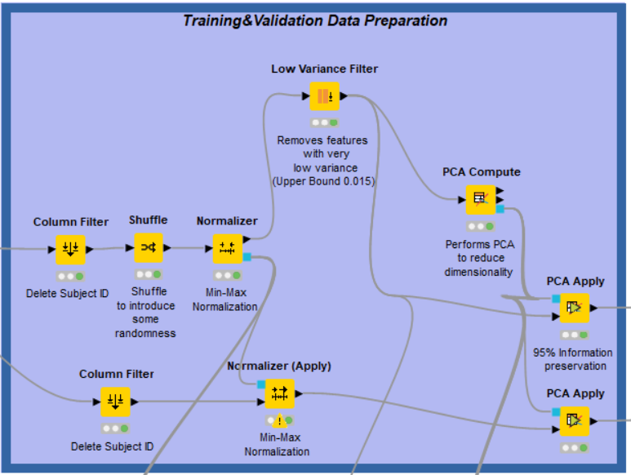
FEATURE ENGINEERING
Removing Subject ID column: it was no longer needed and could introduce bias if left in.
Data Shuffling: To prevent any order-based dependencies during training.
Min-Max Normalization: This scales all features to a range of 0 to 1, preventing features with larger ranges from dominating the learning process.
Low Variance Feature Filtering: To remove features with very low variance.
PCA for Dimensionality Reduction: To preserve 95% of the variance in the data, striking a balance between dimensionality reduction and information retention.
Notes:
Having carefully partitioned our data, we moved on to preparing our features for model training.
1. **Removing Uninformative Features:** We began by removing the Subject ID column, as it was no longer needed after preventing data leakage and could introduce bias if left in.
2. **Data Shuffling:** To further ensure randomness and prevent any order-based dependencies during training, we shuffled the rows in our training set.
3. **Min-Max Normalization:** Since our features were derived from various MRI measurements and likely had different scales, we applied Min-Max normalization. This scales all features to a range of 0 to 1, preventing features with larger ranges from dominating the learning process.
4. **Low Variance Feature Filtering:** Normalization allowed us to effectively analyze feature variance. We used a Low Variance Filter to remove features with very low variance (below a
threshold of 0.015 in our case). These features contribute minimal information to the model and might even introduce noise.
5. **PCA for Dimensionality Reduction:** Even after filtering, our feature space remained quite large. To reduce dimensionality and potentially improve model performance, we applied
Principal Component Analysis (PCA). We configured PCA to preserve 95% of the variance in the data, striking a balance between dimensionality reduction and information retention.

Slide 6

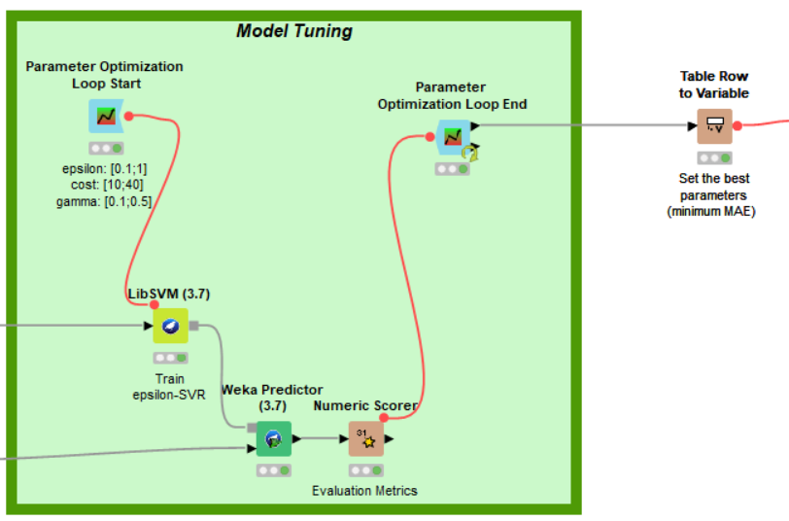
MODEL TUNING AND EVALUATION
Epsilon-SVR model, implemented within the Weka LibSVM nodes, showed the most promising performance.
To optimize our epsilon-SVR model, i performed a parameter optimization loop, focusing on the following key hyperparameters:
Epsilon: This parameter controls the width of the margin within which errors are not penalized.
Cost (C): The cost parameter determines the trade-off between maximizing the margin and minimizing training errors.
Gamma: This parameter defines the influence of a single training example
The optimal hyperparameter combination was selected based on the lowest Mean Absolute Error (MAE) achieved on the validation set.
Notes:
With our data thoroughly prepared, we experimented with various regression models. After initial evaluations, we found that the epsilon-Support Vector Regression (epsilon-SVR) model, implemented within the Weka LibSVM nodes, showed the most promising performance.
To optimize our epsilon-SVR model, we performed a parameter optimization loop, focusing on the following key hyperparameters:
- **Epsilon:** This parameter controls the width of the margin within which errors are not penalized. A smaller epsilon leads to a narrower margin and potentially a more complex model.
- **Cost (C):** The cost parameter determines the trade-off between maximizing the margin and minimizing training errors. A higher cost penalizes errors more heavily, potentially leading to
overfitting.
- **Gamma:** This parameter defines the influence of a single training example. A smaller gamma means a wider influence, resulting in a smoother decision boundary.
We systematically explored a range of values for each hyperparameter [mention the ranges you used] using the Parameter Optimization Loop.
The optimal hyperparameter combination was selected based on the lowest Mean Absolute Error (MAE) achieved on the validation set.

Slide 7

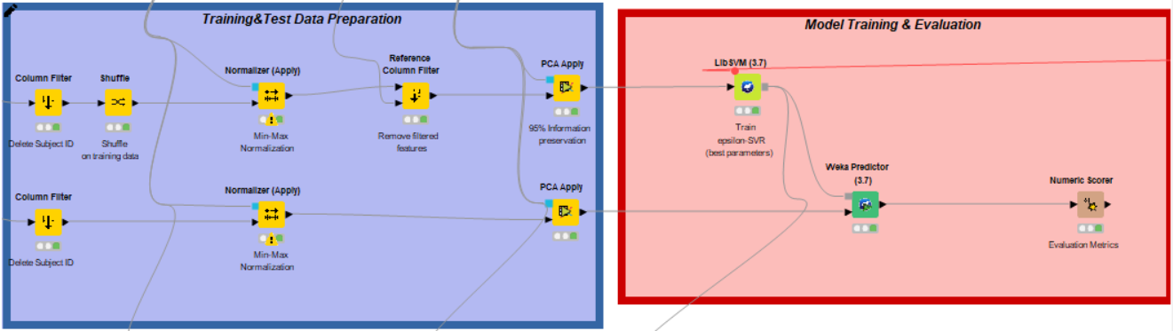

FINAL DATA PREPARATION
AND MODEL TRAINING
With optimal hyperparameters determined, i moved on to training the final model.
Combining Training and Validation Sets: This gives our model more data to learn from during the final training phase.
Consistent Preprocessing with "Apply" Nodes: To ensure consistency and prevent data leakage, we applied the exact same preprocessing steps
This approach provides a realistic and generalizable assessment of the model's performance.
Notes:
With our optimal hyperparameters determined, we moved on to training our final model.
1. **Combining Training and Validation Sets:** Since the parameter optimization loop helped us find the best model configuration using the validation set, we combined our training and validation data. This gives our model more data to learn from during the final training phase.
2. **Consistent Preprocessing with "Apply" Nodes:** To ensure consistency and prevent data leakage, we applied the exact same preprocessing steps (Subject ID removal, Min-Max normalization, low variance feature filtering, and PCA) to both the combined training/validation set and the held-out test set.
- **Crucially, we used the "Apply" versions of the Normalizer and PCA nodes.** These nodes apply the transformations learned from the training data to the test data, maintaining the independence of the test set and preventing any information leakage from the test set back into the model.
**Model Evaluation and Conclusion**
We then trained our epsilon-SVR model using the preprocessed combined training/validation data and the best-performing hyperparameters identified earlier. Finally, we used the trained model to predict the ages of the patients in the held-out test set.
- **Our final MAE score on the test set was [state your MAE score].** While this score might be slightly higher than some approaches that don't rigorously address data dependencies and potential leakage, we believe our approach provides a more realistic and generalizable
assessment of the model's performance.
**Key Takeaways:**
- **Data Leakage Prevention is Paramount:** In longitudinal studies like this, preventing data leakage is absolutely crucial for building reliable and generalizable models.
- **Consistent Preprocessing is Key:** Using "Apply" nodes for transformations like normalization and PCA ensures that the test data remains independent and prevents subtle forms of data leakage.
- **Transparent and Reproducible Workflow:** KNIME facilitated a clear and reproducible workflow, allowing us to carefully control each step of the process and ensure the integrity of our
results.

Slide 8

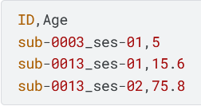
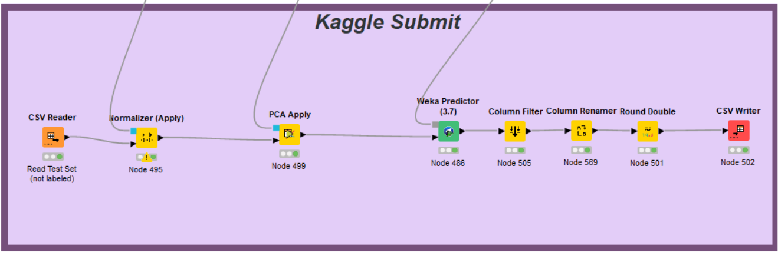
GENERATING PREDICTIONS
AND SUBMITTING TO KAGGLE
This part of the workflow focuses on preparing the test set and formatting our predictions for submission.
Loading the unlabeled Test Set
Applying Preprocessing Transformations
Predicting with the Trained Model
Formatting the Submission
Writing the Submission File
Notes:
Now, for the final step: generating predictions for the Kaggle competition. This part of the workflow focuses on preparing the test set and formatting our predictions for submission.
1. **Loading the Test Data:** We start by reading in the original, unlabeled test set provided by Kaggle using the "CSV Reader" node.
2. **Applying Preprocessing Transformations:** We then apply the exact same preprocessing steps (Min-Max normalization and PCA using the "Apply" nodes) that were used on our training data. This ensures that the test data is transformed in the same way as the data our model was trained on.
3. **Predicting with the Trained Model:** The preprocessed test data is then fed into the "Weka Predictor" node, which contains our trained epsilon-SVR model. The model generates a predicted age for each instance in the test set.
4. **Formatting the Submission:** Before submitting to Kaggle, we need to format our predictions according to their requirements:
- **Column Filtering:** We use a "Column Filter" to keep only the essential columns: the unique identifier for each instance and the predicted age.
- **Column Renaming:** We use a "Column Renamer" to match the exact column names specified by the competition guidelines.
- **Rounding:** Finally, we use the "Round Double" node to round our predicted ages to the nearest integer, as required by the competition.
5. **Writing the Submission File:** Finally, we use the "CSV Writer" node to save our formatted predictions into a CSV file, ready for submission to the Kaggle competition.

Slide 9
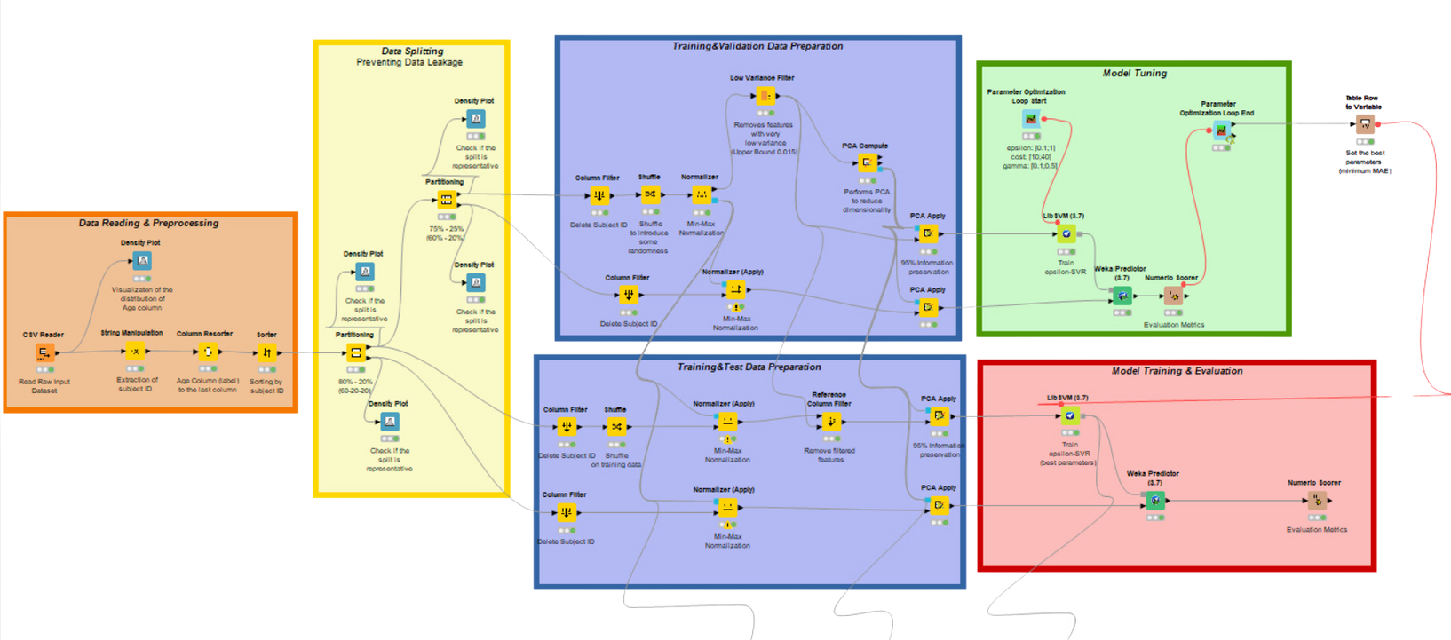
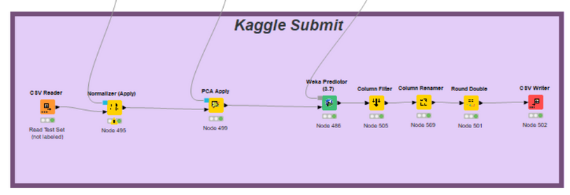
COMPLETE WORKFLOW
Notes:
Now, for the final step: generating predictions for the Kaggle competition. This part of the workflow focuses on preparing the test set and formatting our predictions for submission.
1. **Loading the Test Data:** We start by reading in the original, unlabeled test set provided by Kaggle using the "CSV Reader" node.
2. **Applying Preprocessing Transformations:** We then apply the exact same preprocessing steps (Min-Max normalization and PCA using the "Apply" nodes) that were used on our training data. This ensures that the test data is transformed in the same way as the data our model was trained on.
3. **Predicting with the Trained Model:** The preprocessed test data is then fed into the "Weka Predictor" node, which contains our trained epsilon-SVR model. The model generates a predicted age for each instance in the test set.
4. **Formatting the Submission:** Before submitting to Kaggle, we need to format our predictions according to their requirements:
- **Column Filtering:** We use a "Column Filter" to keep only the essential columns: the unique identifier for each instance and the predicted age.
- **Column Renaming:** We use a "Column Renamer" to match the exact column names specified by the competition guidelines.
- **Rounding:** Finally, we use the "Round Double" node to round our predicted ages to the nearest integer, as required by the competition.
5. **Writing the Submission File:** Finally, we use the "CSV Writer" node to save our formatted predictions into a CSV file, ready for submission to the Kaggle competition.

Slide 10
Thank You
Notes:
Thank You for the attention

